Slide 1

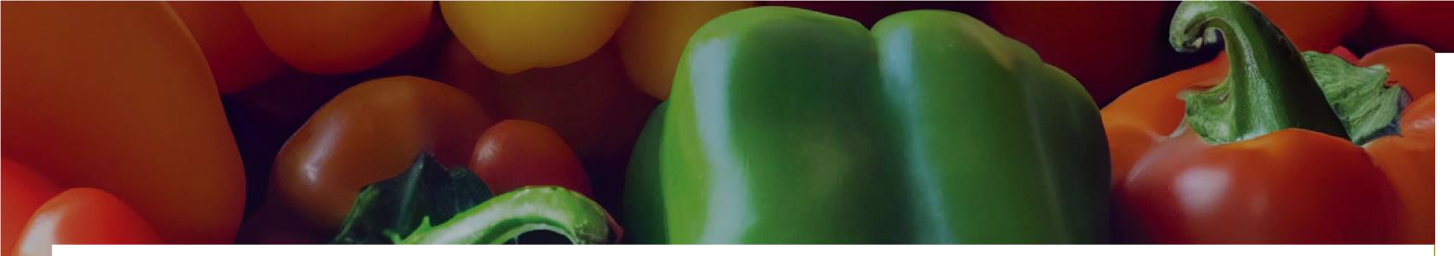



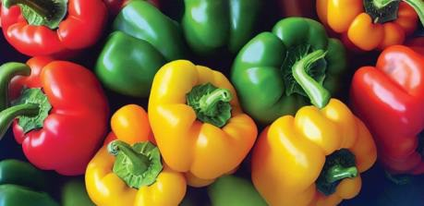
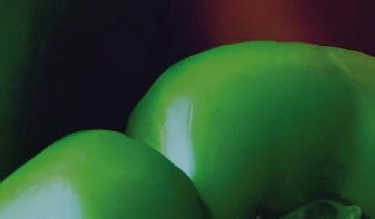





August 2026 School Name
Sunday Monday Tuesday Wednesday Thursday Friday Saturday
Bell Peppers Season in Texas: May - June; August -November Did you know? The longer a bell pepper is left to ripen, the sweeter it becomes |  |  |  |  | 31 Menu Items | 1 Menu Items | Announcements Announcement text goes here. Copy and paste the Texas icon as many times as you need to place on the days your menu featuresTexas products.
2 Menu Items | 3 Menu Items | 4 Menu Items | 5 Menu Items | 6 Menu Items | 7 Menu Items | 8 Menu Items
9 | 10 Menu Items | 11 | 12 | 13 | 14 | 15
Menu Items |  | Menu Items | Menu Items | Menu Items | Menu Items | Menu Items
16 | 17 Menu Items | 18 | 19 | 20 | 21 | 22
Menu Items |  | Menu Items | Menu Items | Menu Items | Menu Items | Menu Items
23 | 24 Menu Items | 25 | 26 | 27 | 28 | 29
Menu Items |  | Menu Items | Menu Items | Menu Items | Menu Items | Menu Items
_{square www.SquareMeals.org} This product was funded by USDA. This institution is an equal opportunity provider. _{Updated 05/20/26}
meals
s funded by USDA. This institution is an equal oppo

Slide 2
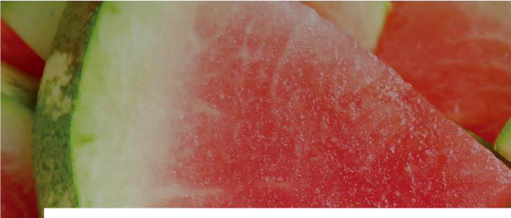
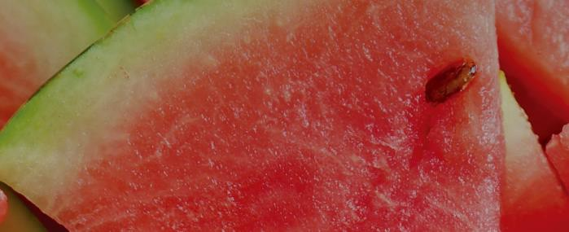
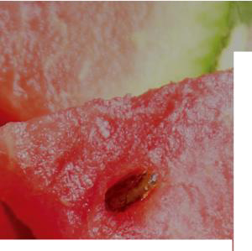


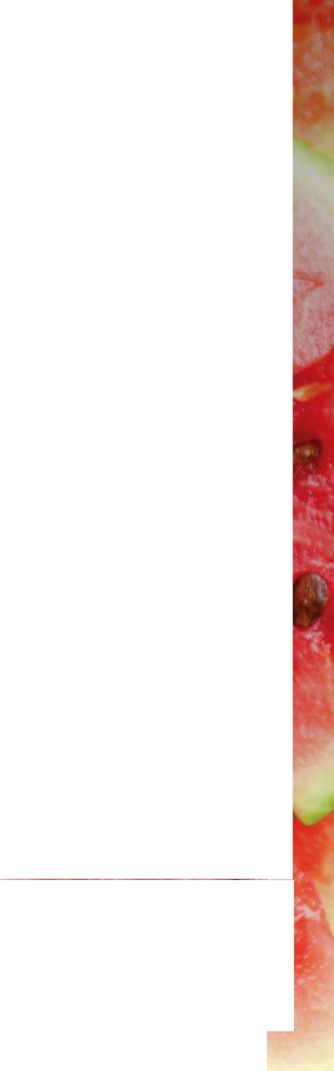
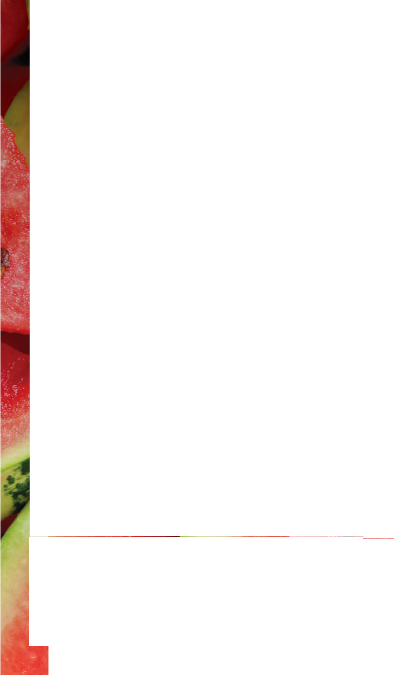
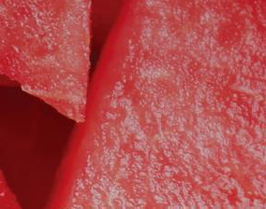
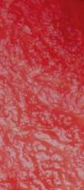

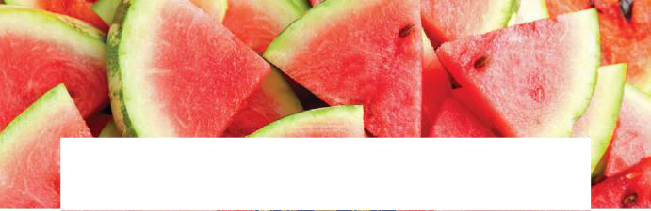

September 2026
Sunday Monday |  |  | Tuesday Wednesday Thursday Friday Saturday
30 |  | 31 | 1 | 2 | 3 | 4 | 5 | Announcements
Menu Items |  | Menu Items | Menu Items | Menu Items | Menu Items | Menu Items | Menu Items | Announcement text goes here.
 |  |  |  |  |  |  |  | Copy and paste the Texas icon as many times as you need to place on the days your menu features Texas products.
6 Menu Items |  | 7 Menu Items | 8 Menu Items | 9 Menu Items | 10 Menu Items | 11 Menu Items | 12 Menu Items
13 |  | 14 | 15 | 16 | 17 | 18 | 19
Menu Items |  | Menu Items | Menu Items | Menu Items | Menu Items | Menu Items | Menu Items
20 |  | 21 | 22 | 23 | 24 | 25 | 26
Menu Items |  | Menu Items | Menu Items | Menu Items | Menu Items | Menu Items | Menu Items
27 |  | 28 | 29 |  |  |  |  | Watermelon
Menu Items |  | Menu Items | Menu Items |  |  |  | Season You can some people ma | in Texas: May - October Did you know? eat the entire watermelon; ke sweet pickles out of the rind
square | www.SquareMeals.org |  | This product was funded by USDA. This institution is an equal opportunity provider. |  |  |  |  | Updated 05/20/26
School Name
Announcements
meals
s funded by USDA. This institution is an equal oppo

Slide 3
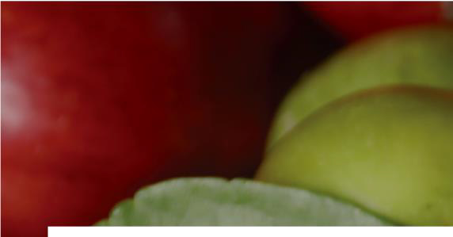
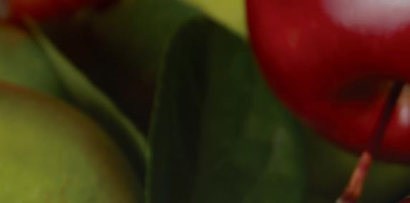
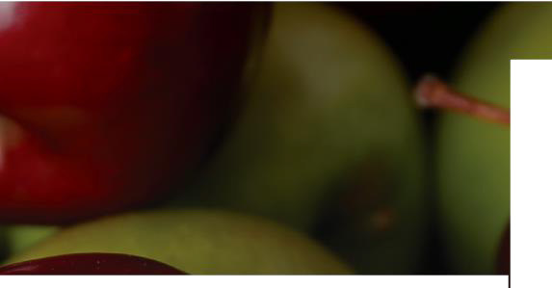


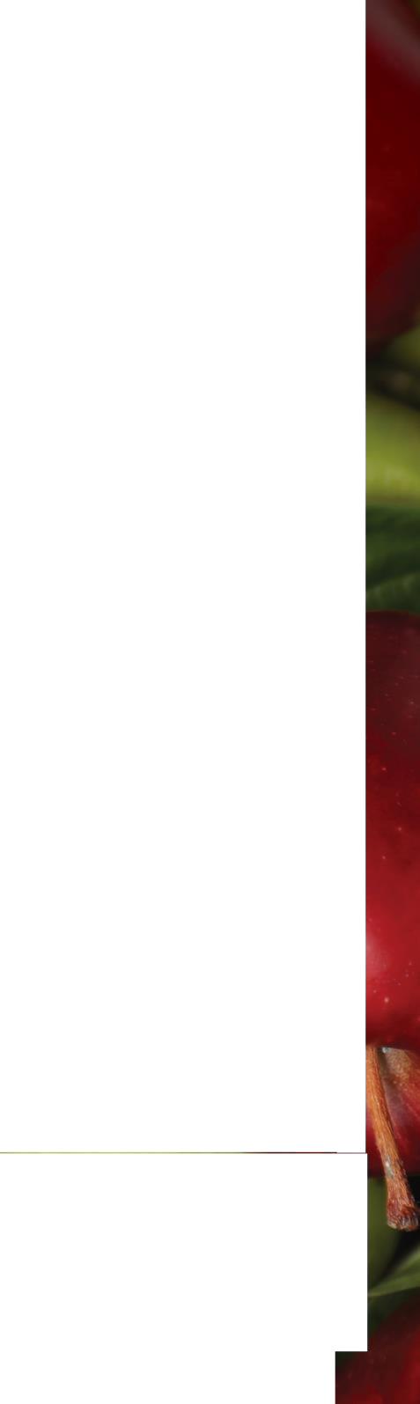

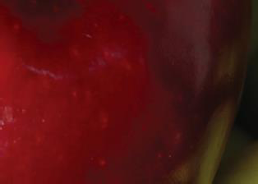

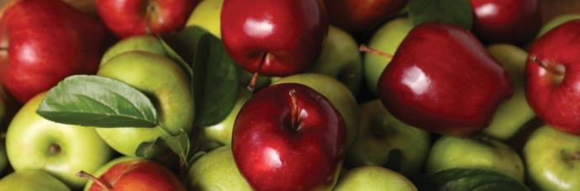

October 2026
Sunday Monday Tuesday Wednesday Thursday Friday Saturday |  |  |  |  |  |  | Announcements Announcement text goes here. Copy and paste the Texas icon as many times as you need to place on the days your menu features Texas products.
Apples Season in Texas: July-November Did you know? There are about 2,500 different kinds of apples grown in the United States |  |  | 30 Menu Items | 1 Menu Items | 2 Menu Items | 3 Menu Items
4 Menu Items | 5 Menu Items | 6 Menu Items | 7 Menu Items | 8 Menu Items | 9 Menu Items | 10 Menu Items
11 Menu Items | 12 Menu Items | 13 Menu Items | 14 Menu Items | 15 Menu Items | 16 Menu Items | 17 Menu Items
18 Menu Items | 19 Menu Items | 20 Menu Items | 21 Menu Items | 22 Menu Items | 23 Menu Items | 24 Menu Items
25 Menu Items | 26 Menu Items | 27 Menu Items | 28 Menu Items | 29 Menu Items | 30 Menu Items
_{square www.SquareMeals.org} This product was funded by USDA. This institution is an equal opportunity provider. Updated 05/20/26
School Name
meals
s funded by USDA. This institution is an equal oppo

Slide 4

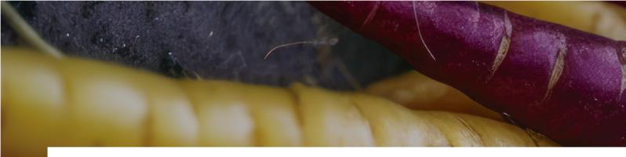
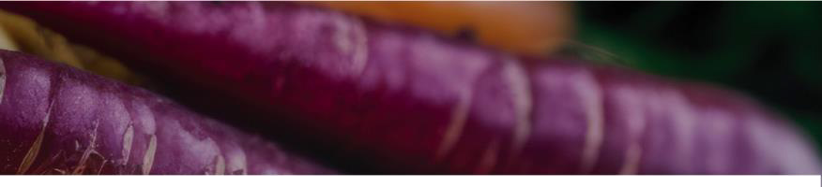
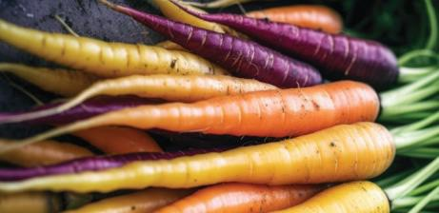
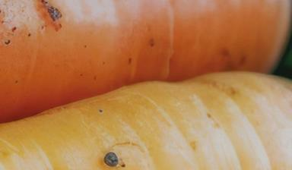




November 2026
 |  |  |  |  |  |  | Announcements Announcement text goes here. Copy and paste the Texas icon as many times as you need to place on the days your menu features Texas products.
Sunday Monday Tuesday Wednesday Thursday Friday Saturday
Carrots Season in Texas: August - May Did you know? You can eat all parts of the carrot; leaves can be made into pesto or added to a salad, carrot flowers can also be added to salads or turned into jelly, the seeds are used to flavor other foods |  |  |  |  |  | 31 Menu Items
1 Menu Items | 2 Menu Items | 3 Menu Items | 4 Menu Items | 5 Menu Items | 6 Menu Items | 7 Menu Items
8 Menu Items | 9 Menu Items | 10 Menu Items | 11 Menu Items | 12 Menu Items | 13 Menu Items | 14 Menu Items
15 Menu Items | 16 Menu Items | 17 Menu Items | 18 Menu Items | 19 Menu Items | 20 Menu Items | 21 Menu Items
22 Menu Items | 23 Menu Items | 24 Menu Items | 25 Menu Items | 26 Menu Items | 27 Menu Items | 28 Menu Items
_{square www.SquareMeals.org} This product was funded by USDA. This institution is an equal opportunity provider. Updated 05/20/26
School Name
meals
s funded by USDA. This institution is an equal oppo

Slide 5

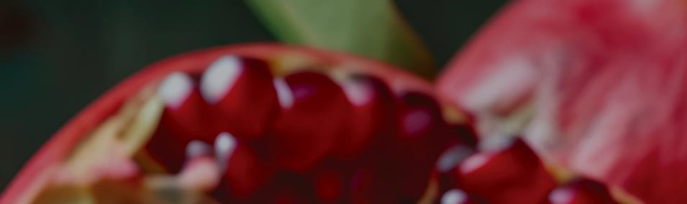
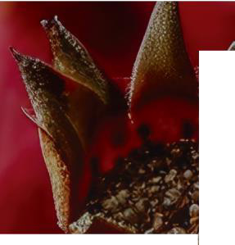

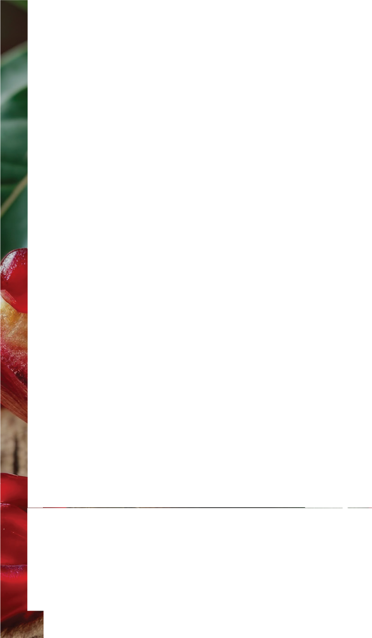
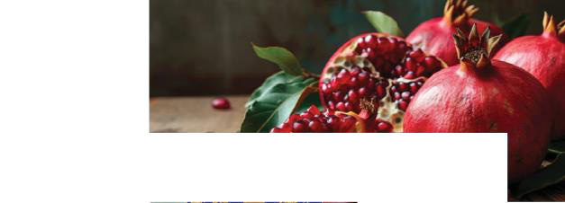


December 2026
 |  |  |  |  |  |  | Announcements Announcement text goes here. Copy and paste the Texas icon as many times as you need to place on the days your menu features Texas products.
29 Menu Items | 30 Menu Items | 1 Menu Items | 2 Menu Items | 3 Menu Items | 4 Menu Items | 5 Menu Items
6 Menu Items | 7 Menu Items | 8 Menu Items | 9 Menu Items | 10 Menu Items | 11 Menu Items | 12 Menu Items
13 Menu Items | 14 Menu Items | 15 Menu Items | 16 Menu Items | 17 Menu Items | 18 Menu Items | 19 Menu Items
20 Menu Items | 21 Menu Items | 22 Menu Items | 23 Menu Items | 24 Menu Items | 25 Menu Items | 26 Menu Items
27 Menu Items | 28 Menu Items | 29 Menu Items | 30 Menu Items |  |  | Pomegranates Season in Texas: October - December Did you know? Pomegranate trees can live for over 200 years
School Name
Sunday Monday Tuesday
Wednesday
Thursday
Friday
Saturday
meals
square
www.SquareMeals.org
This product was funded by USDA. This institution is an equal opportunity provider.
Updated 05/20/26
s funded by USDA. This institution is an equal oppo

Slide 6
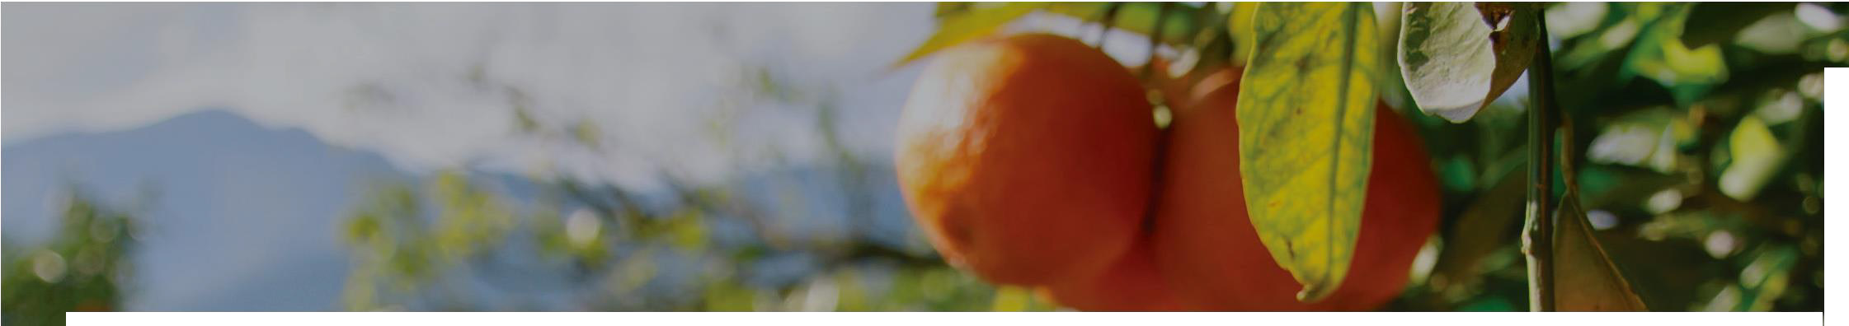




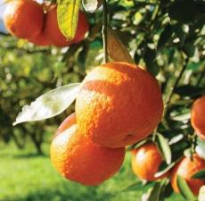
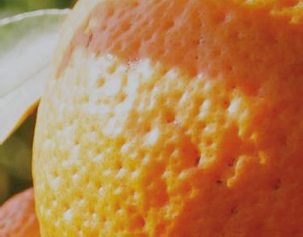


January 2027
Sunday Monday Tuesday Wednesday Thursday Friday Saturday |  |  |  |  |  |  | Announcements Announcement text goes here. Copy and paste the Texas icon as many times as you need to place on the days your menu features Texas products.
Oranges Season in Texas: September - April Did you know? Like cantaloupes, oranges won’t ripen once they’re picked |  |  |  | 31 Menu Items | 1 Menu Items | 2 Menu Items
3 Menu Items | 4 Menu Items | 5 Menu Items | 6 Menu Items | 7 Menu Items | 8 Menu Items | 9 Menu Items
10 Menu Items | 11 Menu Items | 12 Menu Items | 13 Menu Items | 14 Menu Items | 15 Menu Items | 16 Menu Items
17 Menu Items | 18 Menu Items | 19 Menu Items | 20 Menu Items | 21 Menu Items | 22 Menu Items | 23 Menu Items
24 Menu Items | 25 Menu Items | 26 Menu Items | 27 Menu Items | 28 Menu Items | 29 Menu Items | 30 Menu Items
_{square www.SquareMeals.org} This product was funded by USDA. This institution is an equal opportunity provider. Updated 05/20/26
School Name
meals
s funded by USDA. This institution is an equal oppo

Slide 7

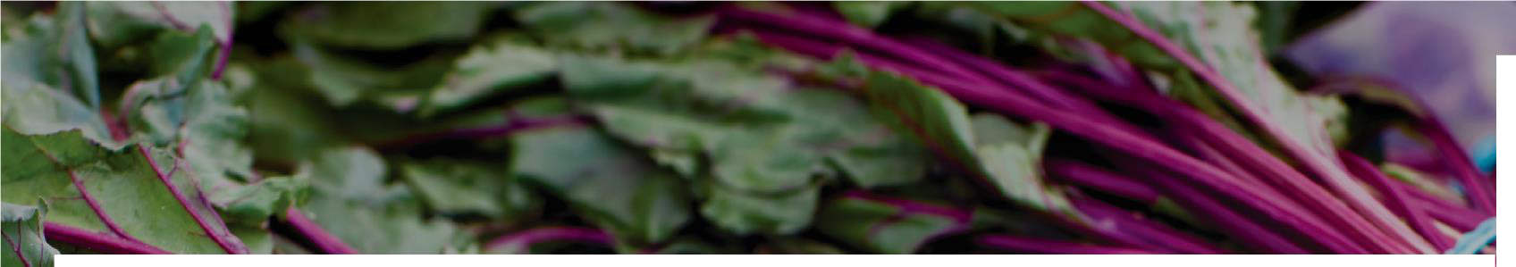

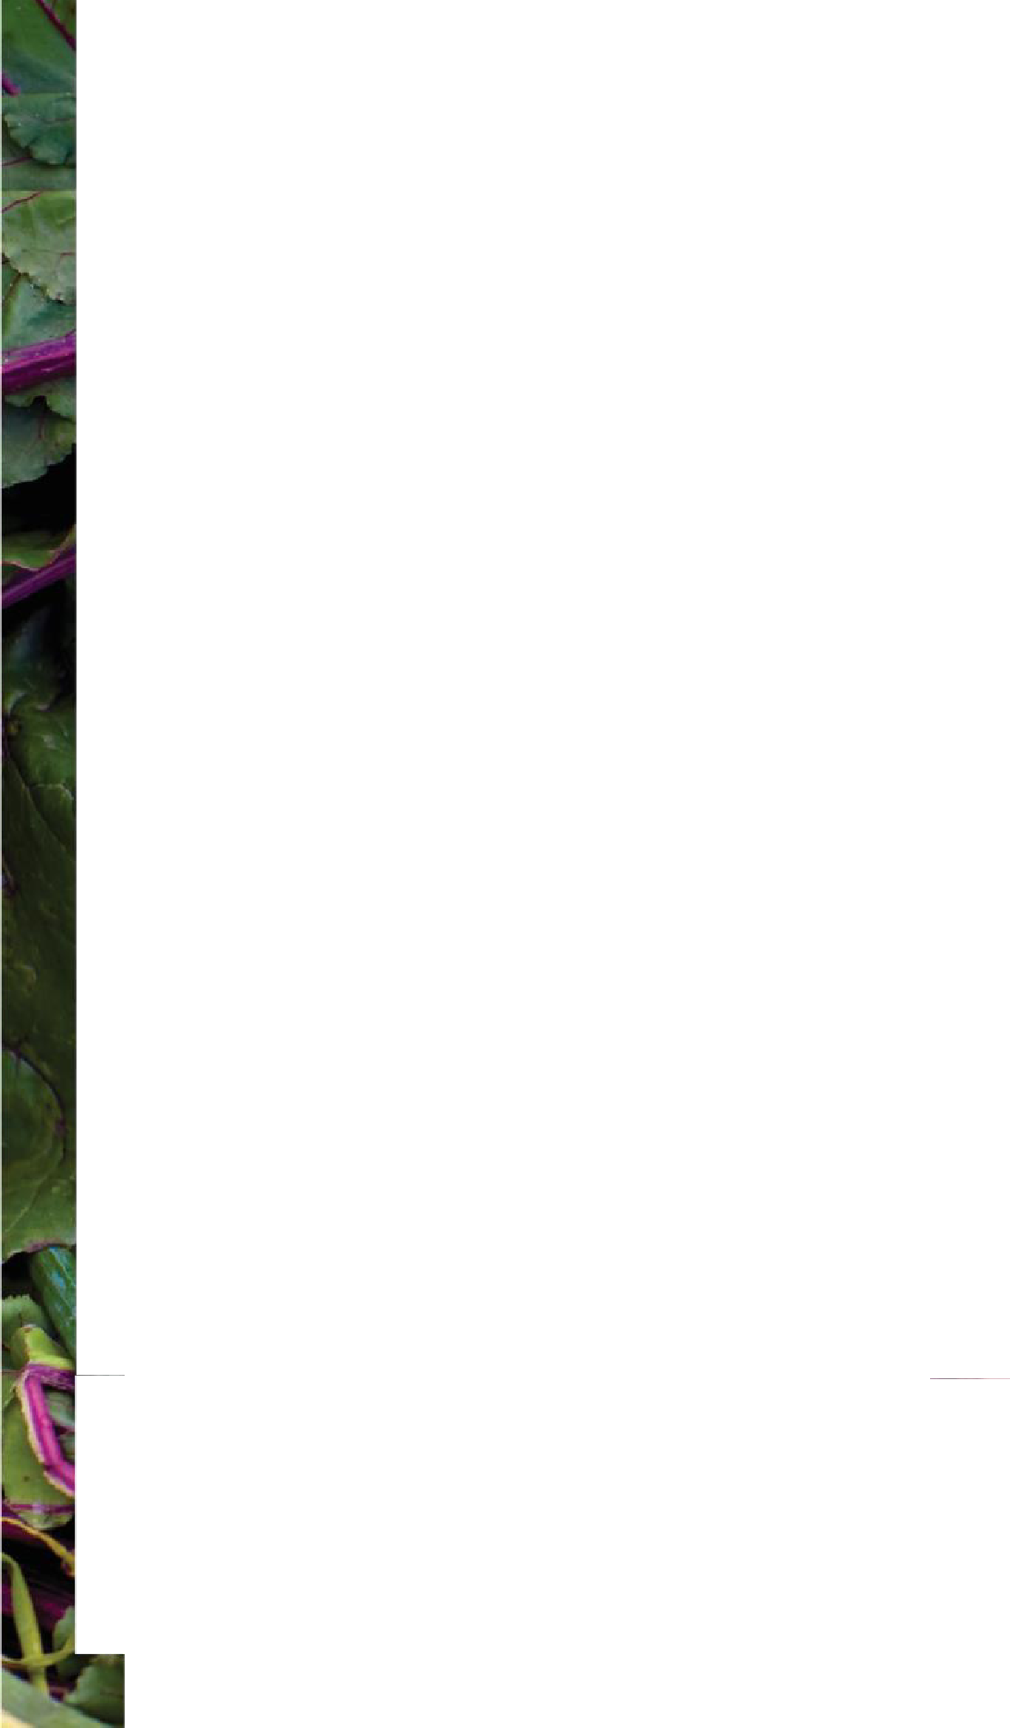
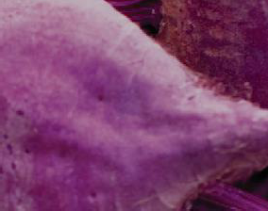

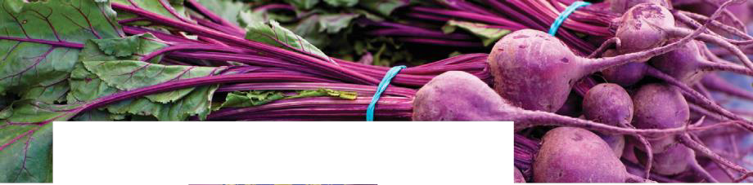

February 2027
 |  |  |  |  |  |  | Announcements Announcement text goes here. Copy and paste the Texas icon as many times as you need to place on the days your menu features Texas products.
Sunday Monday Tuesday Wednesday Thursday Friday Saturday
31 Menu Items | 1 Menu Items | 2 Menu Items | 3 Menu Items | 4 Menu Items | 5 Menu Items | 6 Menu Items
7 Menu Items | 8 Menu Items | 9 Menu Items | 10 Menu Items | 11 Menu Items | 12 Menu Items | 13 Menu Items
14 Menu Items | 15 Menu Items | 16 Menu Items | 17 Menu Items | 18 Menu Items | 19 Menu Items | 20 Menu Items
21 Menu Items | 22 Menu Items | 23 Menu Items | 24 Menu Items | 25 Menu Items | 26 Menu Items | 27 Menu Items
Beets Season in Texas: January - March; September - November Did you know? The main part of the beet that is eaten is the root; you can also eat the greens
_{square www.SquareMeals.org} This product was funded by USDA. This institution is an equal opportunity provider. Updated 05/20/26
School Name
meals
s funded by USDA. This institution is an equal oppo

Slide 8
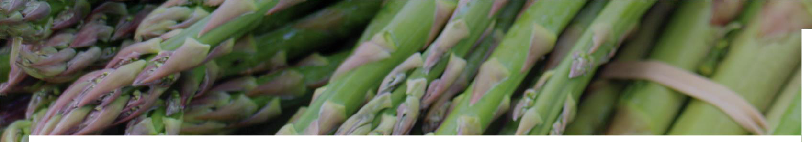


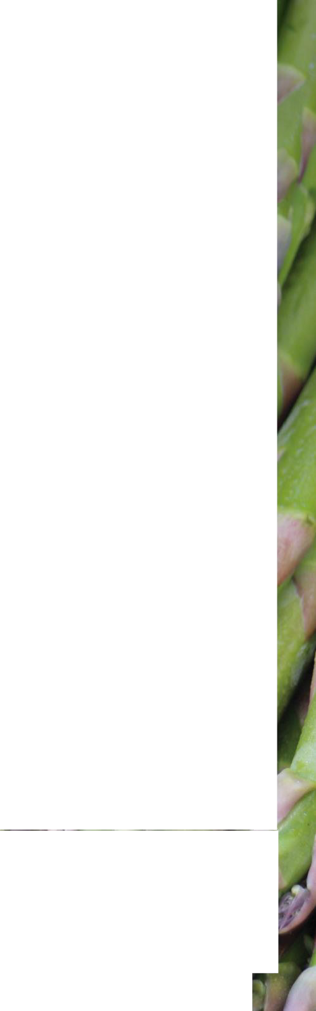
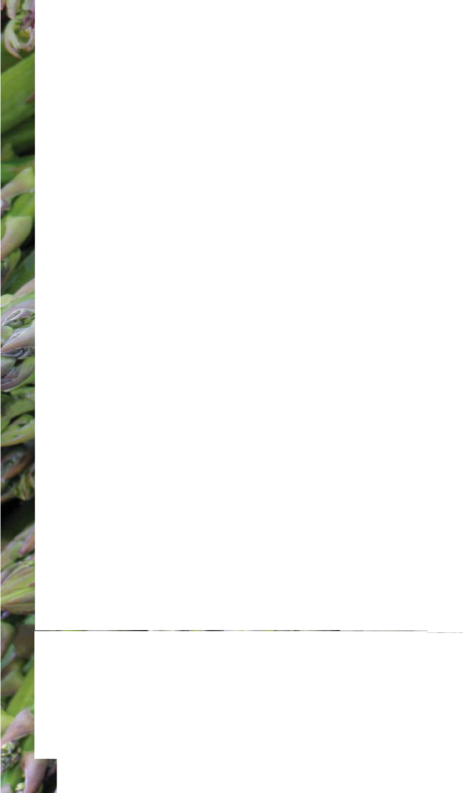
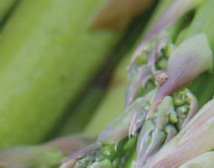
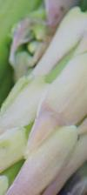
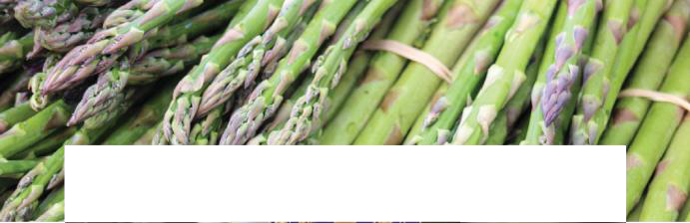

March 2027
Sunday Monday Tuesday Wednesday Thursday Friday Saturday
28 Menu Items | 1 Menu Items | 2 Menu Items | 3 Menu Items | 4 Menu Items | 5 Menu Items | 6 Menu Items | Announcements Announcement text goes here. Copy and paste the Texas icon as many times as you need to place on the days your menu features Texas products.
7 Menu Items | 8 Menu Items | 9 Menu Items | 10 Menu Items | 11 Menu Items | 12 Menu Items | 13 Menu Items
14 Menu Items | 15 Menu Items | 16 Menu Items | 17 Menu Items | 18 Menu Items | 19 Menu Items | 20 Menu Items
21 Menu Items | 22 Menu Items | 23 Menu Items | 24 Menu Items | 25 Menu Items | 26 Menu Items | 27 Menu Items
28 Menu Items | 29 Menu Items | 30 Menu Items |  |  |  | Season It takes three year the | Asparagus in Texas: March - April Did you know? s to pick fully-grown asparagus from time you plant the seed
_{square www.SquareMeals.org} This product was funded by USDA. This institution is an equal opportunity provider. _{Updated 05/20/26}
School Name
meals
s funded byUSDA. This institution isan equaloppo

Slide 9
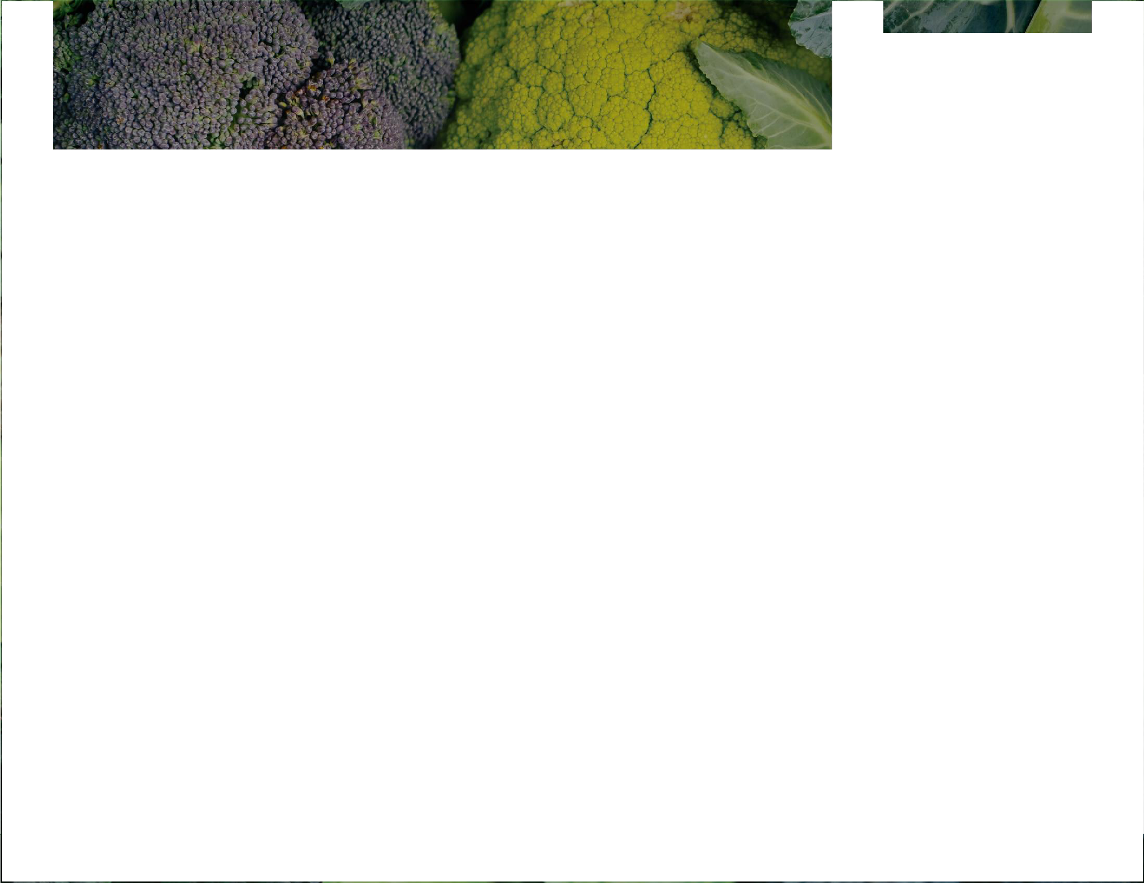
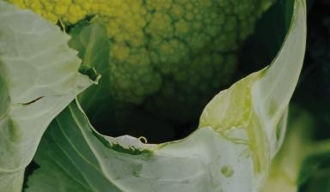
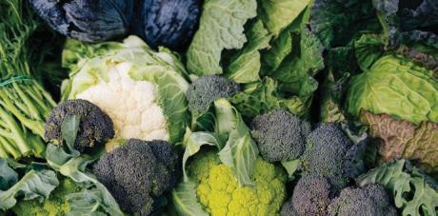



April 2027 School Name |  |  |  |  |  |  | Announcements Announcement text goes here. Copy and paste the Texas icon as many times as you need to place on the days your menu features Texas products.
Sunday Monday Tuesday Wednesday Thursday Friday Saturday
Broccoli Season in Texas: October - May Did you know? Broccoli was cultivated by the Romans from wild cabbage more than 2,000 years ago |  |  | 31 Menu Items | 1 Menu Items | 2 Menu Items | 3 Menu Items
4 Menu Items | 5 Menu Items | 6 Menu Items | 7 Menu Items | 8 Menu Items | 9 Menu Items | 10 Menu Items
11 Menu Items | 12 Menu Items | 13 Menu Items | 14 Menu Items | 15 Menu Items | 16 Menu Items | 17 Menu Items
18 Menu Items | 19 Menu Items | 20 Menu Items | 21 Menu Items | 22 Menu Items | 23 Menu Items | 24 Menu Items
25 Menu Items | 26 Menu Items | 27 Menu Items | 28 Menu Items | 29 Menu Items
_{square www.SquareMeals.org} This product was funded by USDA. This institution is an equal opportunity provider. Updated 05/20/26
meals
s funded by USDA. This institution is an equal oppo

Slide 10
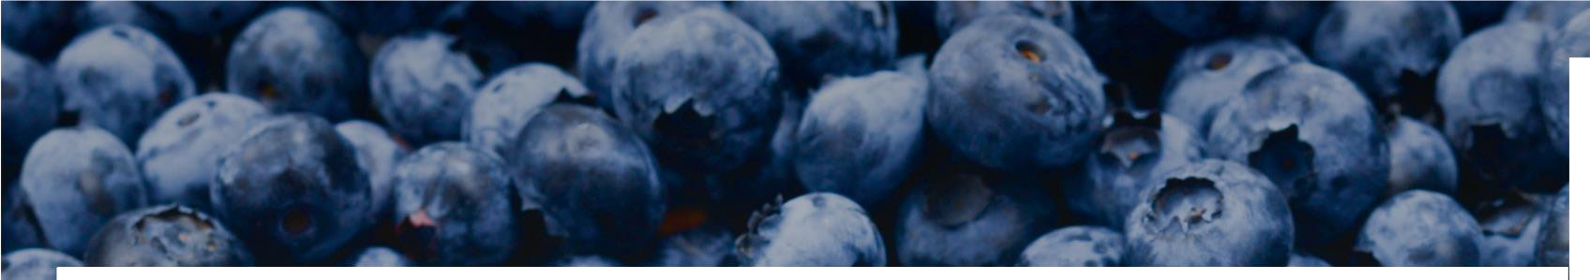




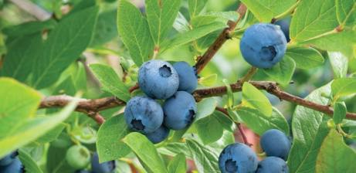
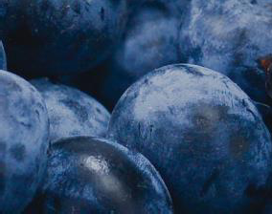
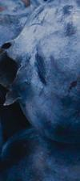

May 2027
Sunday Monday Tuesday Wednesday Thursday Friday Saturday |  |  |  |  |  |  | Announcements Announcement text goes here. Copy and paste the Texas icon as many times as you need to place on the days your menu features Texas products.
Blueberries Season in Texas: May - July Did you know? One blueberry bush can grow up to 6,000 berries every year |  |  |  |  | 30 Menu Items | 1 Menu Items
2 Menu Items | 3 Menu Items | 4 Menu Items | 5 Menu Items | 6 Menu Items | 7 Menu Items | 8 Menu Items
9 Menu Items | 10 Menu Items | 11 Menu Items | 12 Menu Items | 13 Menu Items | 14 Menu Items | 15 Menu Items
16 Menu Items | 17 Menu Items | 18 Menu Items | 19 Menu Items | 20 Menu Items | 21 Menu Items | 22 Menu Items
23 Menu Items | 24 Menu Items | 25 Menu Items | 26 Menu Items | 27 Menu Items | 28 Menu Items | 29 Menu Items
_{square www.SquareMeals.org} This product was funded by USDA. This institution is an equal opportunity provider. Updated 05/20/26
School Name
meals
s funded by USDA. This institution is an equal oppo

Slide 11
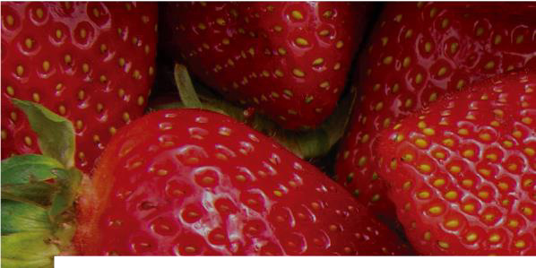
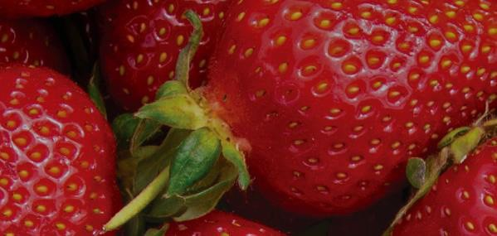
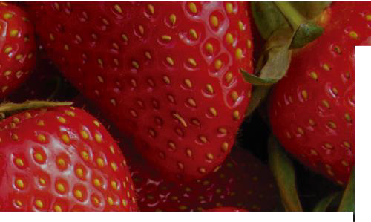

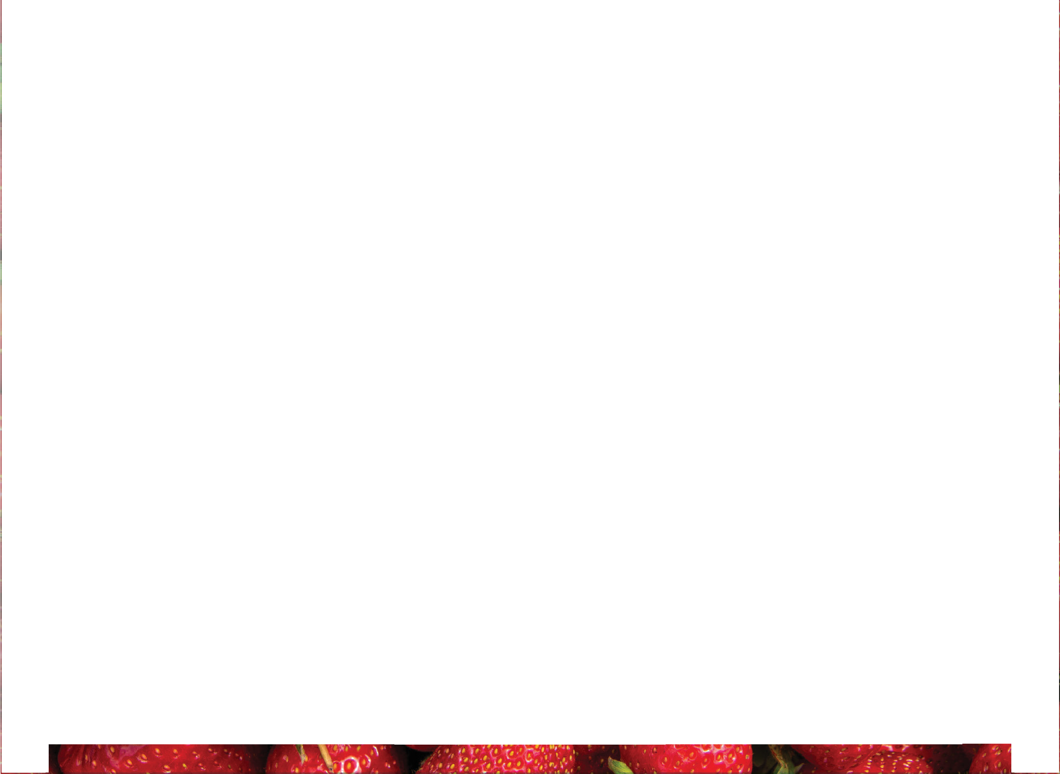
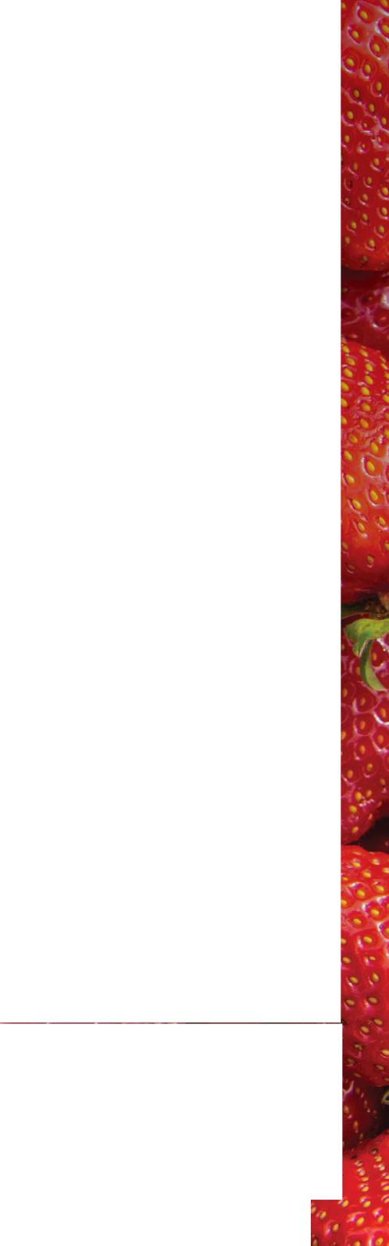








June 2027
Sunday Monday Tuesday Wednesday Thursday Friday Saturday |  |  |  |  |  |  | Announcements Announcement text goes here. Copy and paste the Texas icon as many times as you need to place on the days your menu features Texas products.
30 Menu Items | 31 Menu Items | 1 Menu Items | 2 Menu Items | 3 Menu Items | 4 Menu Items | 5 Menu Items
6 Menu Items | 7 Menu Items | 8 Menu Items | 9 Menu Items | 10 Menu Items | 11 Menu Items | 12 Menu Items
13 Menu Items | 14 Menu Items | 15 Menu Items | 16 Menu Items | 17 Menu Items | 18 Menu Items | 19 Menu Items
20 Menu Items | 21 Menu Items | 22 Menu Items | 23 Menu Items | 24 Menu Items | 25 Menu Items | 26 Menu Items
27 Menu Items | 28 Menu Items | 29 Menu Items |  |  | Strawberries Season in Texas: April - June Did you know? On average, each strawberry has 200 seeds
_{square www.SquareMeals.org} This product was funded by USDA. This institution is an equal opportunity provider. Updated 05/20/26
School Name
meals
s funded by USDA. This institution is an equal oppo

Slide 12









July 2027
Sunday Monday Tuesday Wednesday Thursday Friday Saturday |  |  |  |  |  |  | Announcements Announcement text goes here. Copy and paste the Texas icon as many times as you need to place on the days your menu features Texas products.
Tomatoes Season in Texas: April - December Did you know? Tomatoes are technically a berry |  |  | 30 Menu Items | 1 Menu Items | 2 Menu Items | 3 Menu Items
4 Menu Items | 5 Menu Items | 6 Menu Items | 7 Menu Items | 8 Menu Items | 9 Menu Items | 10 Menu Items
11 Menu Items | 12 Menu Items | 13 Menu Items | 14 Menu Items | 15 Menu Items | 16 Menu Items | 17 Menu Items
18 Menu Items | 19 Menu Items | 20 Menu Items | 21 Menu Items | 22 Menu Items | 23 Menu Items | 24 Menu Items
25 Menu Items | 26 Menu Items | 27 Menu Items | 28 Menu Items | 29 Menu Items | 30 Menu Items | 31 Menu Items
_{square www.SquareMeals.org} This product was funded by USDA. This institution is an equal opportunity provider. Updated 05/20/26
School Name
meals
s funded by . This institution isan equaloppo

